Slide 1



ADVANCE C# CONCEPTS
Presenter
Kushagra Kapoor Mayukh Sinha

Slide 2
AGENDA
1
Generics
2
Collections – List, Dictionary
3
Collections – Stack, Queue
4
Lambda Expression with LINQ
5
SQL Database Connection
6
Delegates and Multi Cast delegates
7
Exception Handling
8
Multi Threading

Slide 3
AGENDA
9
Synchronous Programming
10
Asynchronous Programming
11
Mutex and Locks
12
Semaphores
13
Reflections

Slide 4
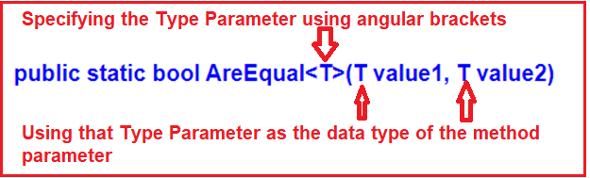
GENERICS
Generic is a class which allows the user to define classes and methods with the placeholder.
Generics are commonly used to create type-safe collections for both reference and value types.
Generic types perform better than normal system types because they reduce the need for boxing, unboxing, and type casting the variables or objects.
A Class or a method, both can be generic.

Slide 5
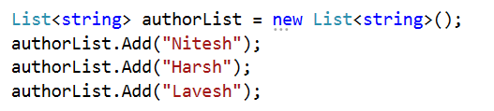
COLLECTIONS – LIST
A list is a collection of items in the System.Collections.Generic namespace.
The List<T> class defined is a generic class and can store any data types to create a list like strings, integers and even complex types.
List can be accessed by index.
It provides functionality to search, sort and manipulate list items.
List can grow dynamically.

Slide 6
BASIC LIST OPERATIONS
List grow in size dynamically
List<string> AuthorList = new List<string>(2); AuthorList.Add("Mahesh Chand"); AuthorList.Add("Praveen Kumar"); AuthorList.Add("Raj Kumar"); AuthorList.Add("Mahesh Chand");
Accessing elements of the list Using index:
String authorInfo = AuthorList[2]; Iterating through list: Foreach(string s in AuthorList)
{
Console.writeline(s);
}
Count Elements of list AuthorList.Count;
Get Index of an element in list
AuthorList.IndexOf(“Mahesh Chand”)
AuthorList.IndexOf(“Mahesh Chand”, startFromIndex)
Insert Element at specified index
AuthorList.Insert(2, “abc”);

Slide 7
LIST OPERATIONS CONT’D…
Contains: Checks if an item exists in the list. Returns true/false.
Exists: Checks if an item exists in the list based on a condition. Returns true/false.
Find: Searches for an element and returns first matching item from the list.
FindLast: Searches for an element and returns last matching item from the list.
FindAll: Returns all the items from the list matching the condition.
FindIndex: Returns the first index of the specified element.

Slide 8
LIST RANGE OPERATIONS
Allows to add another list of item to the end of the list.
Gets list of items from the list.
Expects 2 parameters, start element and number of elements to return.
Removes range of from the list. Expects 2 parameters, start element and number of elements to remove.
Allows us to insert a list of items into the list at a specified index.
AddRange()
List1.AddRange(List2);
GetRange()
list1.GetRange(3, 2);
RemoveRange()
list1.RemoveRange(0, 2);
Insert Range()
list1.InsertRange(0, list2);

Slide 9
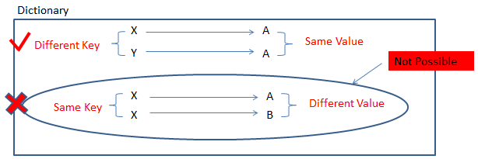
DICTIONARY
The Dictionary type represents a collection of keys and values pair of data.
C# Dictionary class defined in the System.Collections.Generic namespace.
When creating a dictionary, we need to specify the type of key and value.
Each key must be unique in the collection.
Dictionary provides fast lookups for values using keys.

Slide 10
BASIC DICTIONARY OPERATIONS
Dictionary<int,string> AuthorDictionary = new D ictionary<int, string>();
AuthorDictionary.Add(1,"Mahesh Chand"); AuthorDictionary.Add(2,"Praveen Kumar"); AuthorDictionary.Add(3,"Raj Kumar"); AuthorDictionary.Add(4,"Mahesh Chand");
Accessing elements of the dictionary
Using Key:
String authorInfo = AuthorList[2]; Iterating through dictionary :
foreach (KeyValuePair<int, string> author in AuthorDictionary)
{
Console.WriteLine("Key: {0}, Value: {1}", author.Key, auth or.Value);
}
Count Elements of Dictionary
AuthorDictionary.Count;
Find a key & value
AuthorDictionary.ContainsKey(1); AuthorDictionary.ContainsValue("Mahesh Chand");
Remove an Item or all Items
AuthorDictionary.Remove(1) AuthorDictionary.Clear();

Slide 11

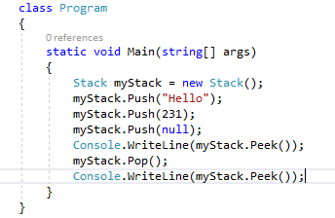
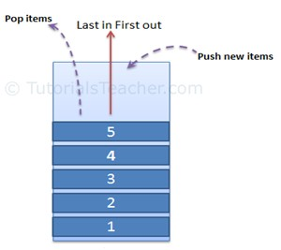
STACKS
LIFO structure
Stack represents a last-in, first out collection of objects. Stack accepts null as a valid value and allows duplicate elements.
Stack operations:
Push: When you add an item in the list.
Pop: When you remove an item from the list. Peek: Returns top element in the list.
Realtime Example: Undo mechanism

Slide 12
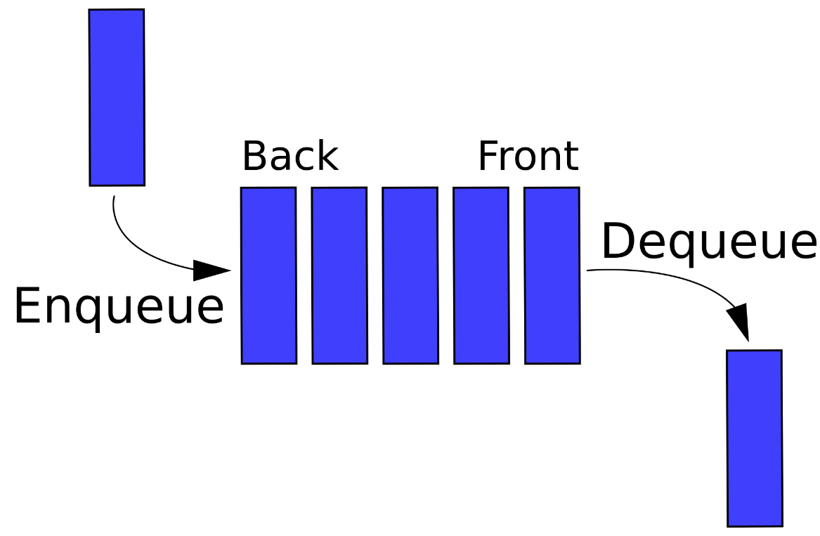
QUEUES
Represents a first-in, first-out collection of objects.
Queues are used when we need to access the information in the same order that it is stored in the collection.
Enqueue – Adds an object to the end of the queue.
Dequeue – Removes and returns an object to the end of
the queue.
Peek – Returns an object at the beginning of the queue without removing it.
Note: Stacks and queues are useful when you need temporary storage for information; that is, when you might want to discard an element after retrieving its value.

Slide 13
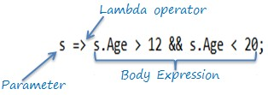
LAMBDA EXPRESSIONS
Lambda expressions are anonymous functions that contain expressions or sequence of operators. All lambda expressions use the lambda operator =>, that can be read as “goes to” or “becomes”.
The lambda operator => divides a lambda expression into two parts. The left side is the input parameter, and the right side is the lambda body.

Slide 14
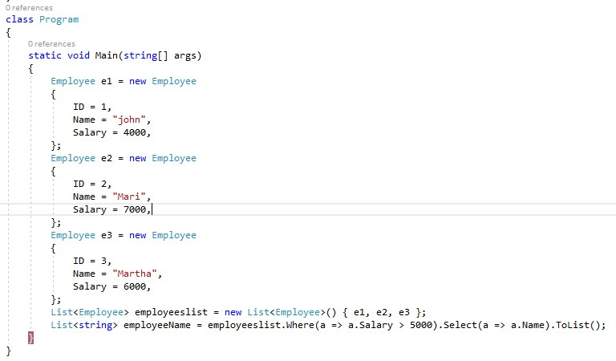
LAMBDA EXPRESSION ALONG WITH LINQ
Where and Select clause
LINQ stands for Language Integrated Query. LINQ enables us to query any type of stored data (SQL data, objects in memory, DataTables).
Where: Filters a sequence of values based on a
predicate
Select: Selects a sequence of values filtered by where clause.

Slide 15

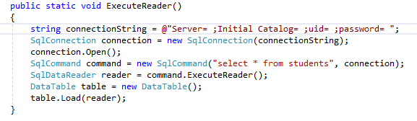
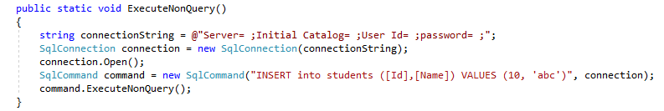
SQL DATABASE CONNECTION
Execute Reader
Execute Non-Query

Slide 16




DELEGATES
A delegate is an object which refers to a method or you can say it is a reference type variable that can hold a reference to the methods.
Declaring Delegates
When we instantiate a delegate, we can associate its instance with any method with a compatible signature and return type.
You can invoke (or call) the method through the delegate instance.
Syntax for delegate declaration is −
delegate <return type> <delegate-name>
<parameter list>
Defining Delegates:
public delegate void MyDelegate (string s);
Instantiating Delegates: MyDelegate del = new MyDelegate(WriteToScreen); Del(“hello”);
Referenced Function
Public void WriteToScreen(string s){ Console.Writeline(s);
}

Slide 17
TYPES OF DELEGATES
Action Delegate: The Action delegate represents a method that takes no parameters and returns void. It is commonly used for methods that perform an action or have a side effect without returning a value.
Func Delegate: The Func delegate represents a method that takes parameters and returns a value. The last type parameter represents the return type.
The Predicate delegate: is a specialized Func delegate where the method takes a single parameter and returns a boolean. It is often used for methods that test a condition.

Slide 18
MULTICAST DELEGATES
Delegate that has references to more than one function
Multicast delegate is a delegate that has references to more than one function.
When we invoke multicast delegate than all the functions the delegate is pointing to are invoked.
It creates an invocation list and add methods to it in the order in which they are added. Approaches to create a multicast delegate:
• + or += ---- To register a delegate
- or -= ----- To unregister a delegate

Slide 19
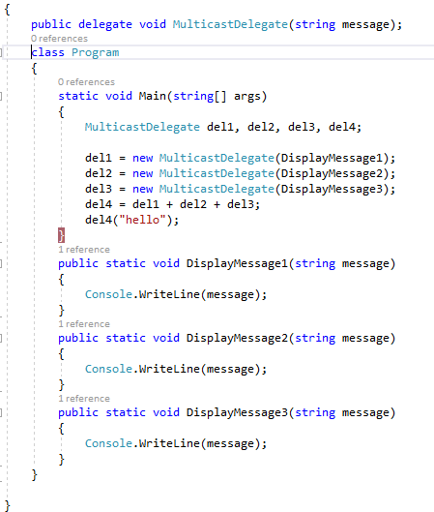
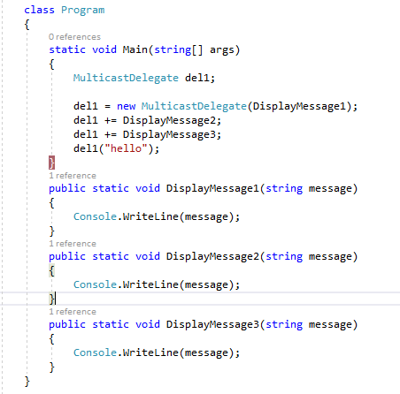
MULTICAST DELEGATE EXAMPLE
Approach 1 Approach 2

Slide 20
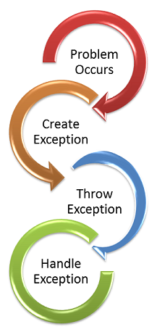
EXCEPTION HANDLING
Try-Catch Blocks: Detect errors in designated code sections using try-catch constructs.
Exception Types: Identify and handle various error scenarios during program execution.
Throwing Exceptions: Intentionally trigger errors with the "throw" keyword for specific conditions.
Finally Block: Execute critical code regardless of errors, enhancing program robustness.
Graceful Error Handling: Ensure smooth recovery from unexpected events for a stable program.
Follow this link to see types of exceptions.

Slide 21
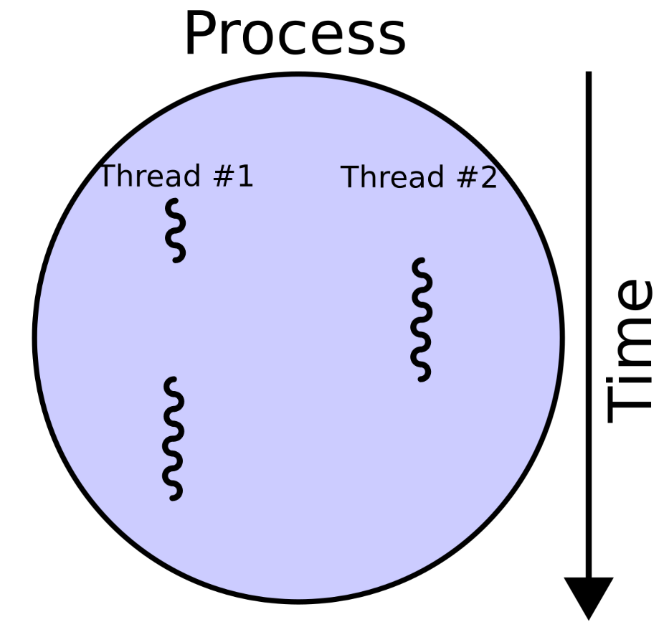
MULTI THREADING
Concurrency: Execute multiple tasks simultaneously for efficient program operation.
Threads: Independent units of execution, allowing parallel processing in C# programs.
Async/Await: Simplify asynchronous programming, enhancing responsiveness.
Thread Synchronization: Manage shared resources to prevent data corruption in parallel execution.
Performance: Improve program speed by leveraging multiple threads for parallel computation.

Slide 22
SYNCHRONOUS PROGRAMMING
Definition:
Synchronous programming is a traditional execution model where each operation blocks the program's execution until it is completed.
Characteristics:
Sequential Flow: Code executes line by line, one operation at a time.
Blocking Nature: Each operation must finish before the next one begins.
Pros:
Simple to Understand: Follows a linear and intuitive flow.
Predictable Execution: Operations occur in a defined order.
Cons:
Potential Delays: If an operation takes time, it can block the entire program.
Reduced Responsiveness: Not ideal for tasks with potential delays (e.g., I/O operations).

Slide 23
ASYNCHRONOUS PROGRAMMING
Definition:
Asynchronous programming is a modern execution model where operations can overlap, allowing the program to perform other tasks while waiting for non-blocking operations to complete.
Characteristics:
Non-Blocking: Operations can start and continue without waiting for the previous ones to finish.
Responsive: Well-suited for scenarios with potentially time-consuming tasks (e.g., I/O operations).
Pros:
Improved Responsiveness: Well-suited for tasks with potential delays.
Efficient Resource Utilization: Allows overlapping of operations.
Cons:
Increased Complexity: Handling asynchronous code may introduce complexities.
Potential Debugging Challenges: Asynchronous stack traces can be harder to interpret.

Slide 24
MUTEX AND LOCK
Mutex Definition:
Mutex (Mutual Exclusion) is a synchronization primitive that ensures only one thread can access a resource at a time.
Mutex Characteristics:
Suitable for inter-process synchronization.
Explicit creation and release of a Mutex object.
Potentially higher overhead.
Lock Definition:
lock is a C# language keyword that simplifies the use of Monitor, providing a convenient way to acquire and release locks.
Lock Characteristics:
Limited to the same AppDomain.
Implicit lock object defined by the expression following the lock keyword.
Generally lower overhead, preferred for short critical sections.

Slide 25
SEMAPHORES
Definition:
A Semaphore is a synchronization primitive that limits the number of threads that can access a resource concurrently.
Semaphore Count:
Specifies the maximum number of threads that can acquire the semaphore simultaneously.
Initialized during semaphore creation.
Use Case:
Ideal for scenarios where you want to limit concurrent access to a resource pool.
Efficiently manages shared resources in a controlled manner.
Allows multiple threads to enter the critical section, but restricts the total concurrency.
Useful for controlling access to a pool of resources.

Slide 26
REFLECTIONS
Definition: Reflection allows dynamic inspection and interaction with type metadata at runtime in C#.
Considerations:
Reflection introduces a performance cost and should be used judiciously.
Alternatives like generics or design patterns may be more suitable in some scenarios.
Takeaway: Reflection provides powerful runtime capabilities but requires careful consideration due to performance implications.
A Simple Use Case of C# Reflection Reflection can be used to create applications called type browsers which allow users to select types and then read the data provided about them.
This example illustrates how to use the static method GetType to find the Type of a variable:
// Using GetType to obtain type information: int i = 42; System.Type type = i.GetType(); System.Console.WriteLine(type); The above example results in the following output: System.Int32
Asynchronous Programming

Slide 27
REFLECTIONS - Continued
EXAMPLE: To access the sample class Calculator from Test.dll assembly, the Calculator class should be defined as the following: namespace Test { public class Calculator { public Calculator() { ... } private double _number; public double Number { get { ... } set { ... } } public void Clear() { ... } private void DoClear() { ... } public double Add(double number) { ... } public static double Pi { ... } public static double GetPi() { ... } } }
Then, you can use reflection to load the Test.dll assembly: // dynamically load assembly from file Test.dll Assembly testAssembly = Assembly.LoadFile(@"c:\Test.dll"); To create an instance of the calculator class: // get type of class Calculator from just loaded assembly Type calcType = testAssembly.GetType("Test.Calculator"); // create instance of class Calculator object calcInstance = Activator.CreateInstance(calcType); And access its members (the following examples illustrate getting values for the public double Number property): // get info about property: public double Number PropertyInfo numberPropertyInfo = calcType.GetProperty("Number"); // get value of property: public double Number double value = (double)numberPropertyInfo.GetValue(calcInstance, null); // set value of property: public double Number numberPropertyInfo.SetValue(calcInstance, 10.0, null);

Slide 28

QUESTIONS?
SOTI Confidential - Only for use under NDA - Do not distribute
SOTI Confidential - Only for use under NDA - Do not distribute

Slide 29





THANK YOU
soti.net
© 2020, SOTI Inc. All Rights Reserved
SOTI Confidential - Only for use under NDA - Do not distribute

